Slide 1

3D Inspection Rover
11-03-2022 20:11:11
Team 8
Bi-Weekly Update 3
Sponsor:
Kevin Nowka
TA:
Eric Robles
Team Members:
Chris Dumont
Dalton Hines
Felipe Villegas
Celeste Waters
Notes:
Normal text size and our names are all size 24
Titles are all size 30 except first and last slides

Slide 2
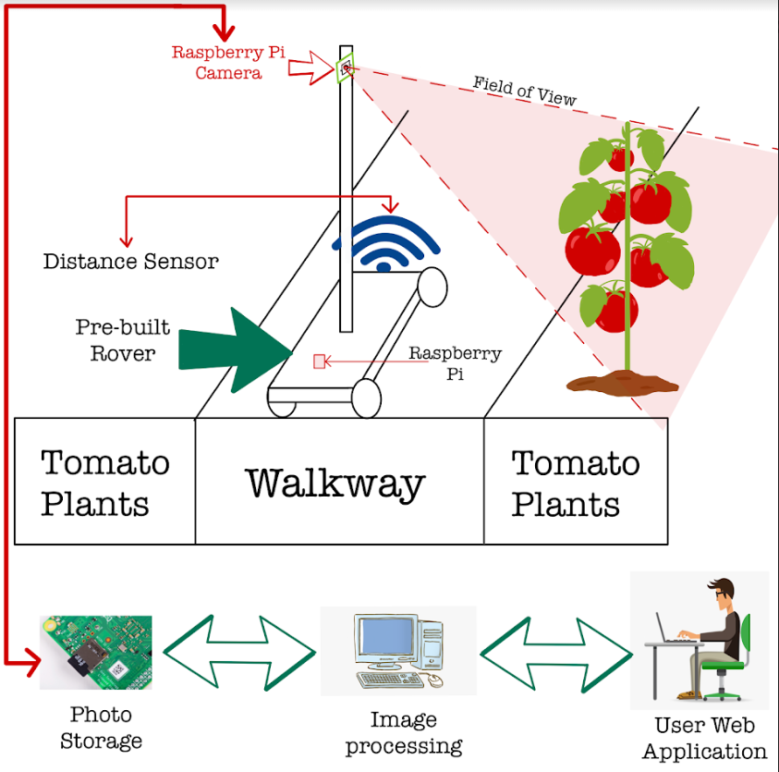
Project Summary
The Problem Is:
Tomato Classification in its current state takes too long
Our Solution Is:
Create a rover that classifies the tomatoes autonomously
Send this data to a database/website that displays yield for the farmer

Slide 3
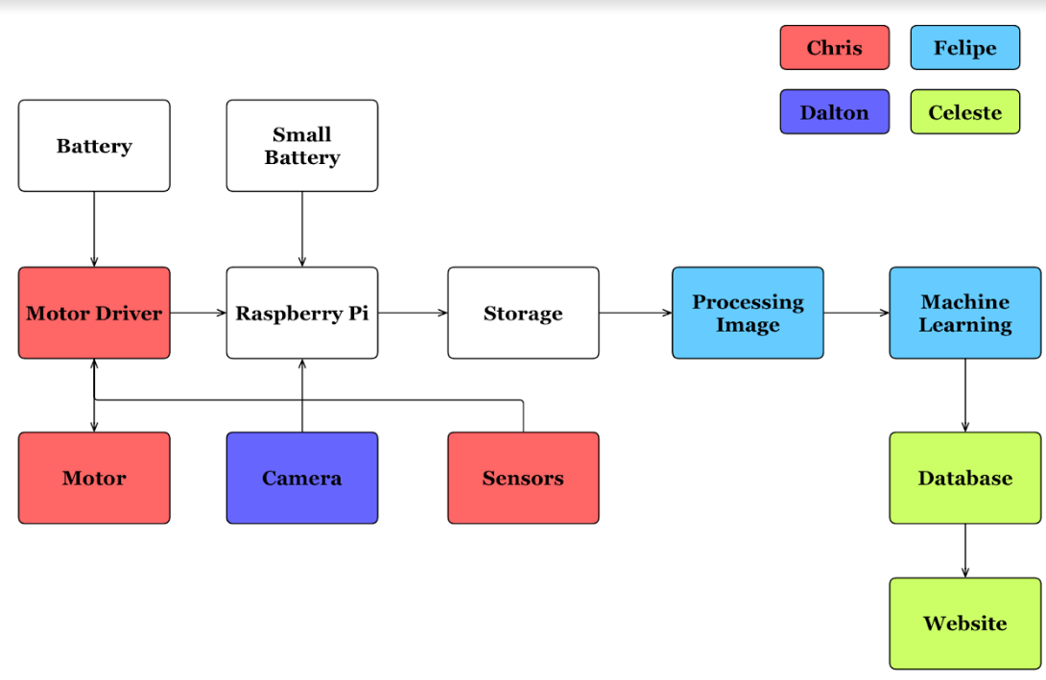
Subsystem Overview
Notes:
Navigation (Red)
Traversing the greenhouse
avoid obstacles in path
Camera Positioning (Purple)
Move Camera up/down mast
Take clear picture of all tomatoes
Image Processing (Blue)
Use machine learning to classify all tomatoes by ripeness
Database/Website (Green)
Save all images
Produce useful charts
Track growth

Slide 4
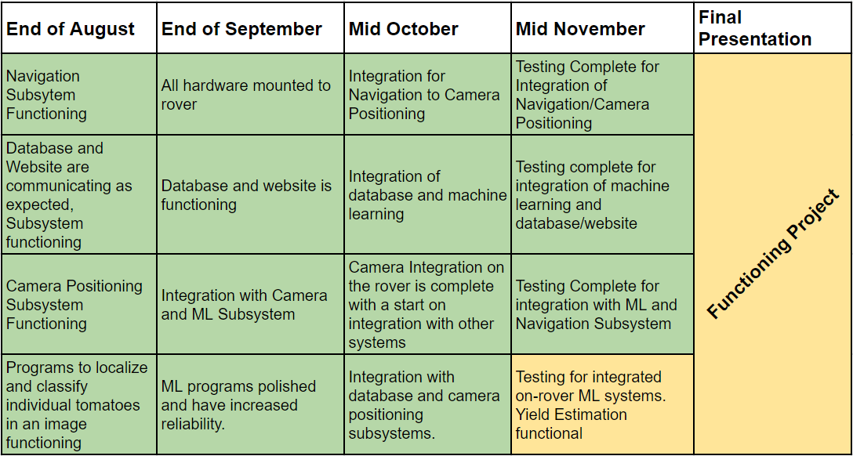
Project Timeline

Slide 5
Navigation, Camera Positioning, & ML Integration
Chris Dumont & Dalton Hines
Accomplishments since last presentation ~ 25 Hours each | Plans until final presentation
Integration of all code across subsystems functions Resolve ML-Camera System Integration Bottlenecks | Perfect timings on Nav/Cam codes Optimization for ML on Raspberry Pi Finish volume estimation Test fail cases Reprint sensor mounts

Slide 6
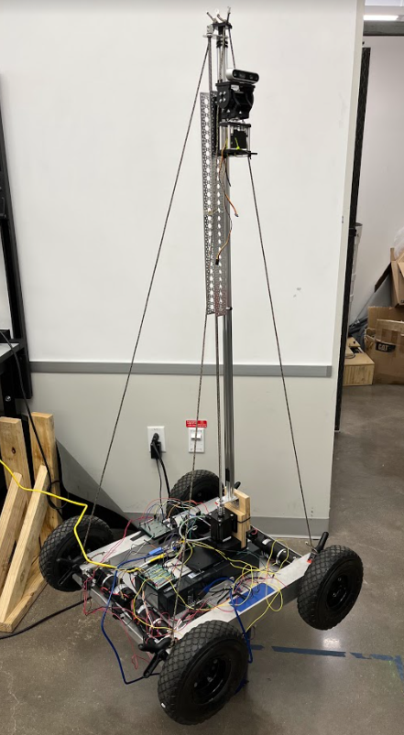
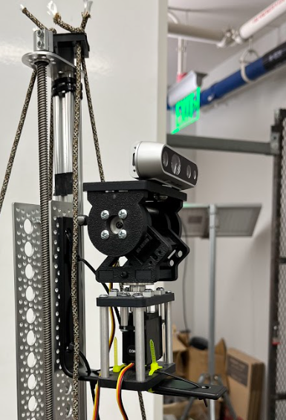
Hardware Mounting
Chris Dumont and Dalton Hines
Improved mast tie-downs
gimbal mounted to mast
does not interfere with cables
Distance sensors stay on rover but need improvement

Slide 7
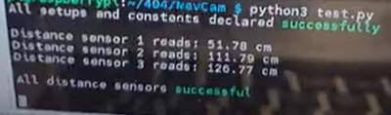
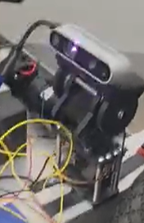
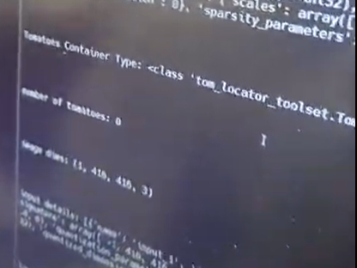
Code Integration
Chris, Dalton and Felipe
Necessary libraries downloaded on Raspberry Pi
All code across Nav/Cam and ML compiles and runs correctly
needs tweaking and optimization
Time on run takes 9 minutes for 1 plant

Slide 8
Website and ML Integration
Celeste and Felipe
Accomplishments since last presentation ~20 hrs each | Plans until next presentation
Code upload data from local storage to database complete Webpage generates bar charts from ML data | Finalize end of route detection and upload behavior Improve time to upload to database Add location of tomato to webpage

Slide 9
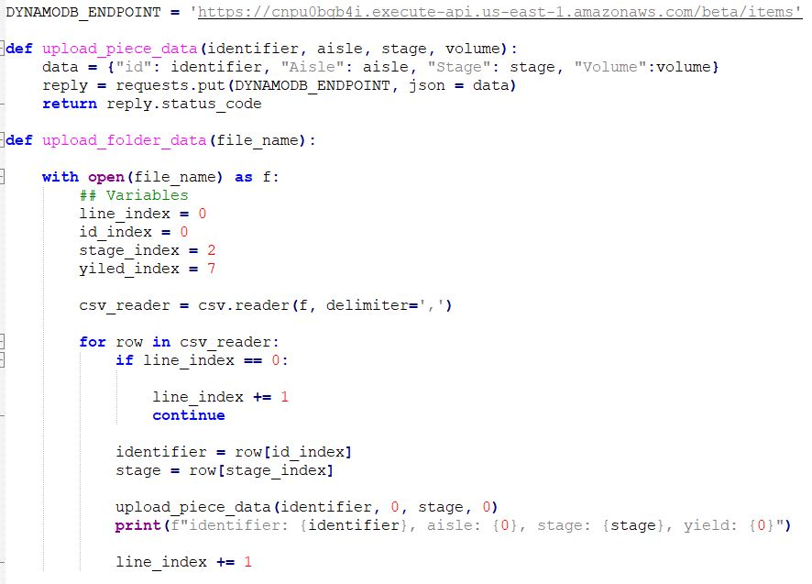
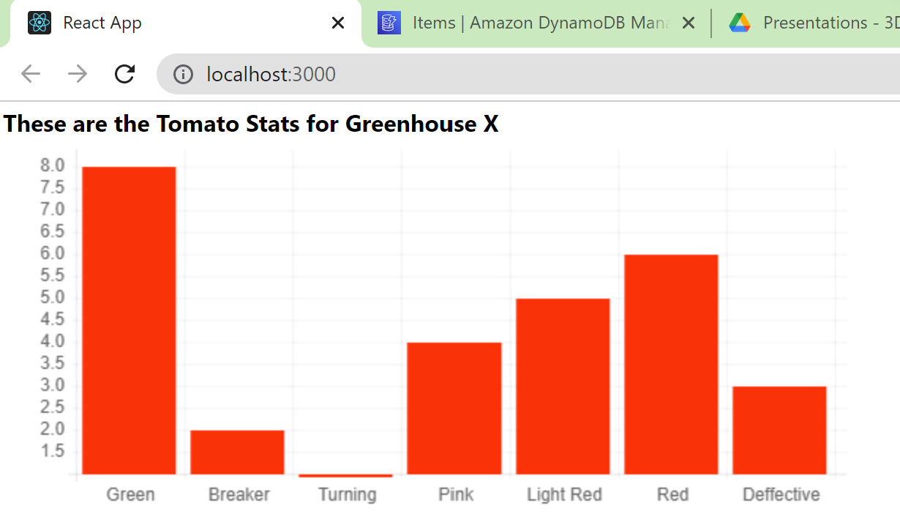
Website and ML Integration
Celeste and Felipe

Slide 10
Parts Ordering Status
Part | Description | Order Placed | Arrived
403 Parts | All Parts needed for 403 | Yes | Yes
Turnbuckle | Used to secure mast to rover | Available in WEB lab | Yes
L-Bracket | Used to mount gimbal to mast | Yes | Yes
Wire | Used to prevent swaying of mast | Available in FEDC | Yes
New Batteries for Rover | Just in case ours die before demo | Yes | No
Longer Camera Cable | Allow full range of motion for camera over mast | Yes | No

Slide 11
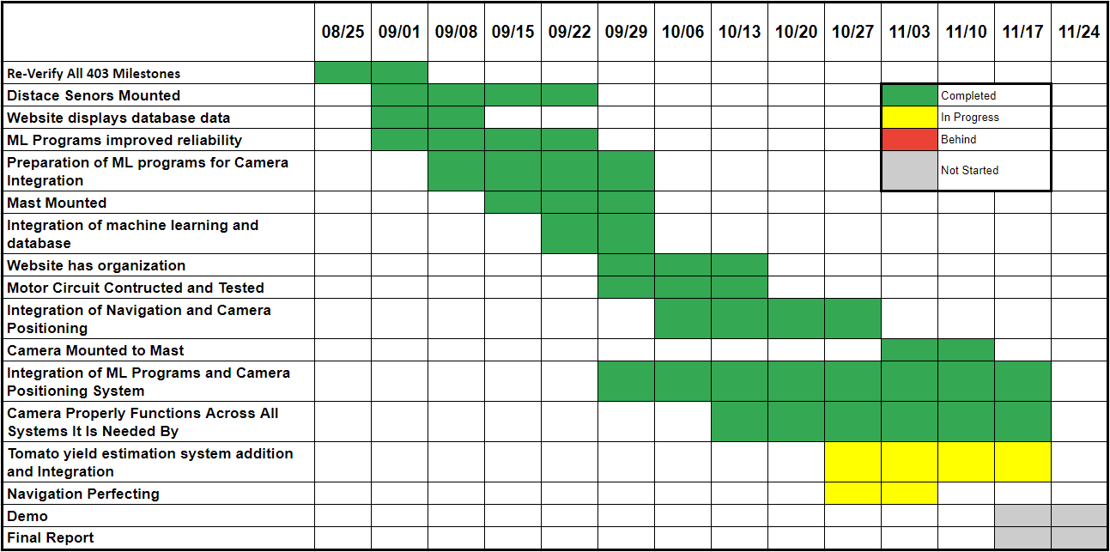
Execution Plan

Slide 12
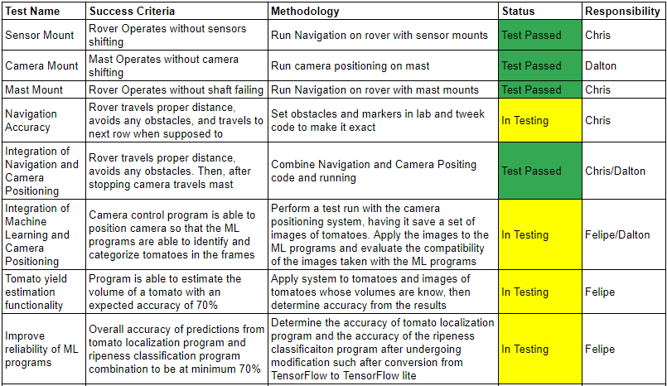

Validation Plan

Slide 13
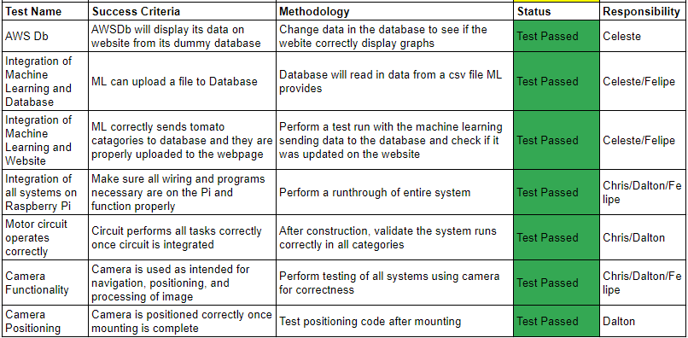
Validation Plan

Slide 14
QUESTIONS

